Slide 1
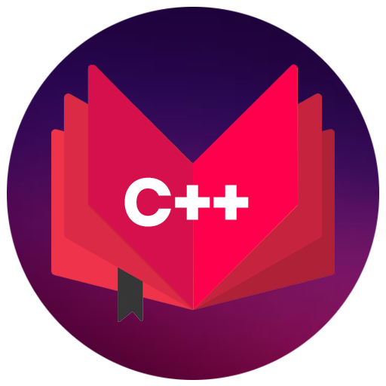
CAP455 OBJECT ORIENTED PROGRAMMING USING C++
Lecture #0 The kick Start Session

Slide 2
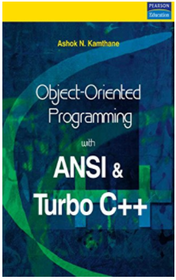
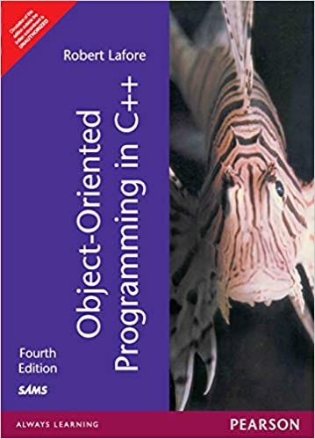
Course Details
LTP: 3 0 2 [3 lectures & 2 Practical per week]
Credits: 4
Text Book
OBJECT ORIENTED PROGRAMMING WITH ANSI &
TRUBO C++ by ASHOK N. KAMTHANE,
PERASON EDUCATION
Reference Books:
Object Oriented Programming
In C++ By Robert Lafore,
Galgotia Publications

Slide 3

Course Assessment Model
Practical CA 50
Attendance 05
End Term Practical 45
Total 100

Slide 4
Prerequisites for the Course
A basic understanding of Programming
(like C, BASIC, etc.)

Slide 5
Course Cohort Mapping (mapping with skill set)
C++ -> Software Engineer/ Software Development Engineer

Slide 6
Course Enrichment
Basic OOPs concepts
Generic programming with templates
Templates and Macros
Pointers

Slide 7
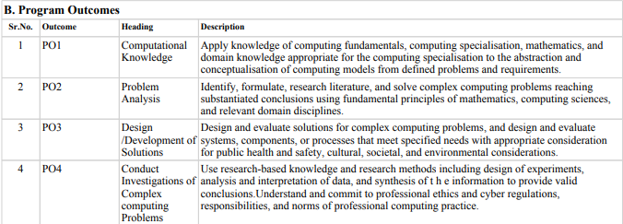
Program Outcomes

Slide 8
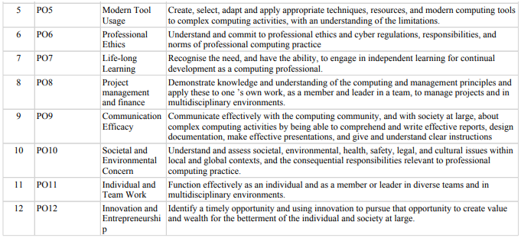
Program Outcomes …

Slide 9
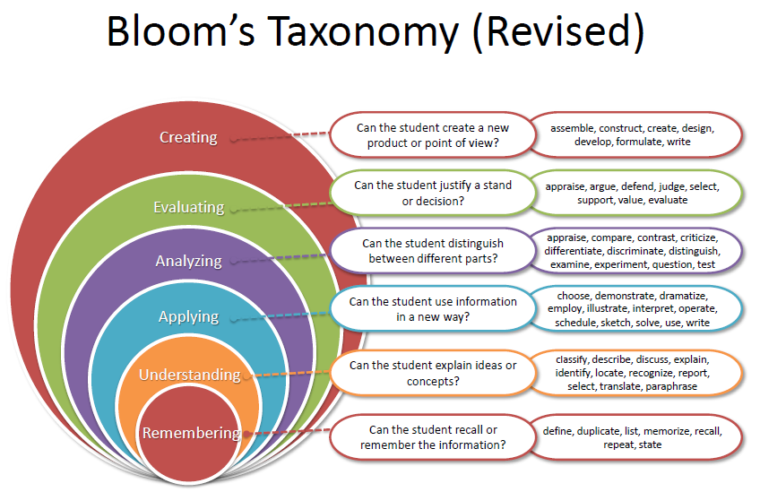

Slide 10
Course Outcomes:
define the fundamental concepts of object-oriented programming
Understand the working of pointers, arrays, and strings
apply dynamic memory management in polymorphism and inheritance to solve real-world problems
analyze unexpected situations and manage them using exception exception-handling mechanism

Slide 11
The Course Content
Principles of OOP’s & C++ essentials
Handling pointers, arrays and string
Constructors, destructors and managing file operations :
Operator overloading, type casting and re-usability
Dynamic memory management and polymorphism
Handling exceptions, templates and STL

Slide 12


Unit Details
Unit 1:
Unit 2:

Slide 13


Unit Details …
Unit 3:
Unit 4:

Slide 14


Unit Details …
Unit 5:
Unit 6:

Slide 15

The hitch…
The three BURNING questions in mind…
Why are we learning C++ language?
What would we do with it?
What will be the course outcome?

Slide 16

Let us re-invent ourselves
To begin with basics…
Let us go to basics.
Let us begin from toddling to learn to walk
Get ready to be childish….

Slide 17
Daily routine
Let us look around our daily routine…
Let us see where all we do programming everyday
Simple things we do to start the day

Slide 18

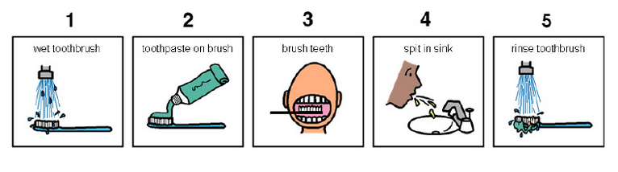
So there is ONE program you know which is there in you…

Slide 19
Daily routine
Start
There is a set procedure
Each step is defined
The occurrence is ordered
Jump is NOT permitted
A step cannot be skipped
Pick Brush
Rinse Brush
Apply Paste
Brush
Rinse Mouth
Rinse Brush
Stop

Slide 20


Daily routine
Let us explore more as the day goes by…
Going for a morning 0900 AM Class
Going for a movie at 0900 AM
It is all about WHICH program is loaded WHEN

Slide 21


Daily routine
The flow changes
Start
Go!!!
Where
To
Go?
Class
Movie
Stop
Stop

Slide 22






Daily routine
Yet another example but more complex
Vision
Sensor
Sipping TEA
Smell
Sensor
Radiation
Sensor
If all sensors
SIP
If even one is
Touch
Sensor
WAIT!!!

Slide 23




So what does this mean?
Take ANY activity of the day…
It will have a set procedure
It has to be done in a designated way
If not done the specified way will yield wrong results.
Success in doing it depends on how closer one is to the prescribed method.
This clearly shows that everything has a
Logic

Slide 24

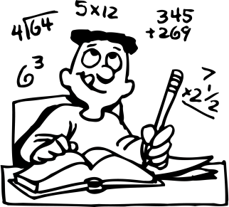
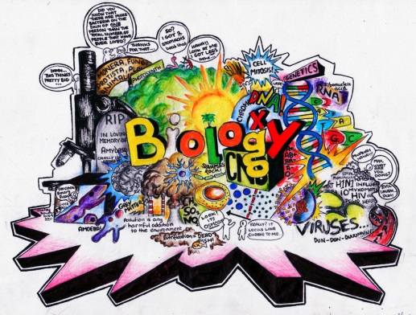





Logic, logic and logic
Logic

Slide 25
What next?
If there is logic in anything and everything
There has to be ways to represent logic
There has to be modes to modify and re-represent logic.
There should be methodology to implement and re-design logic.
And for all this…

Slide 26


What next?
There has to be logic machine to assimilate, understand, solve, store, retrieve and represent logic
There has to be a LANGUAGE to communicate with the logic machine
Otherwise….

Slide 27



Diving deeper…
How do I get A+ grade in CAP455?

Slide 28


Diving deeper…
How do I get A+ grade in CAP455?
If marks are greater than or equal to 85.
A program written in C++ language with LOGIC

Slide 29
Acknowledgements
The Khan Academy
EdX
Coursera
Cplusplus.com
www.cppforschool.com
Learncpp.com
And Above all…
Common Sense

Slide 30
Next :Principles of OOP's

